Slide 1
Calculating Family Expenses Using Servicenow Vamsi
SlideMake.com

Slide 2

Introduction to Calculating Family Expenses with ServiceNow Vamsi
This presentation explains how to utilize ServiceNow Vamsi for managing and calculating family expenses.
ServiceNow Vamsi offers a streamlined platform for tracking financial data efficiently.
Understanding this process helps families optimize their budgeting and expense planning.
Notes:
Image source: https://img.freepik.com

Slide 3
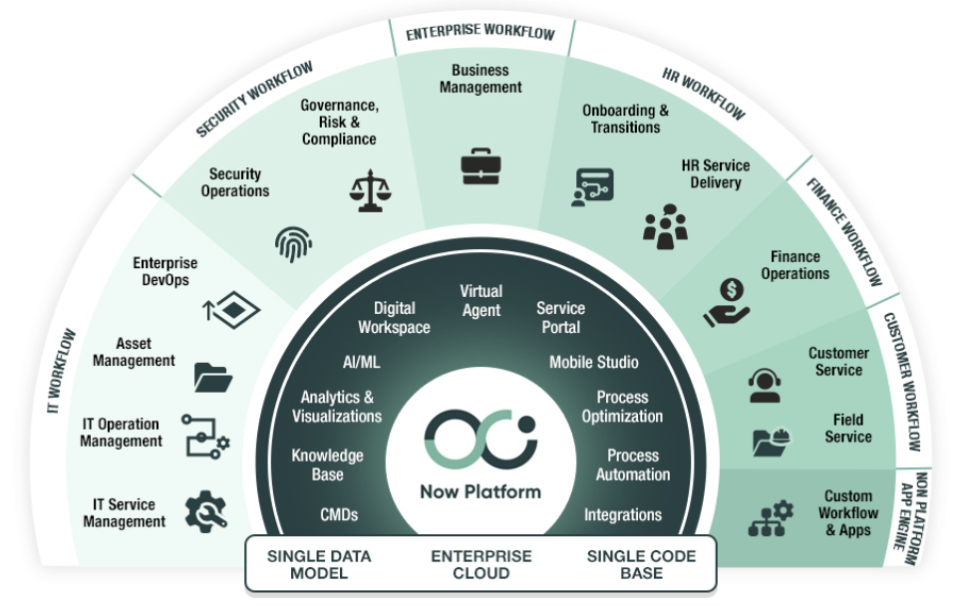
Overview of ServiceNow Vamsi Platform
ServiceNow Vamsi is a versatile tool designed for financial management and automation.
It integrates various data sources to provide comprehensive expense insights.
The platform features customizable dashboards tailored to individual family budgeting needs.
Notes:
Image source: https://velog.velcdn.com

Slide 4
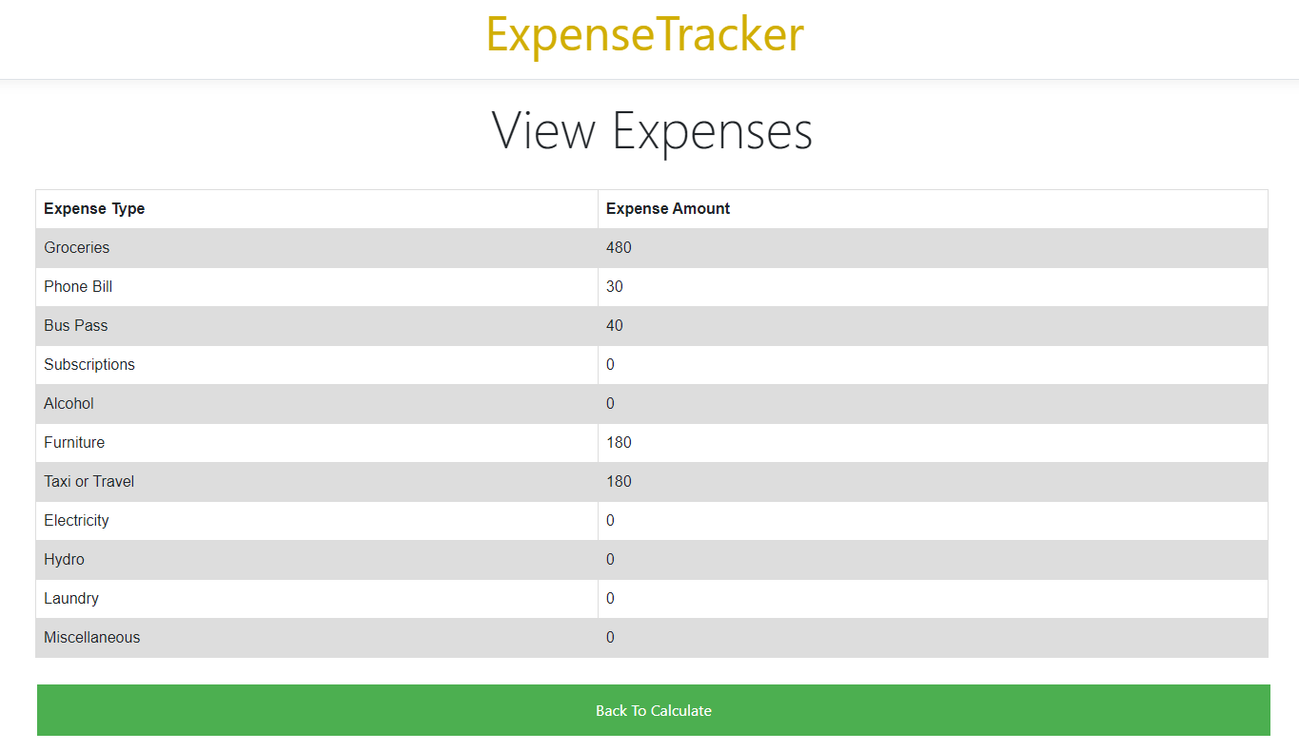
Setting Up Expense Categories in Vamsi
Begin by creating specific categories such as groceries, utilities, and education expenses.
Assign each expense to its relevant category for better tracking.
Proper categorization helps in analyzing spending patterns accurately.
Notes:
Image source: https://user-images.githubusercontent.com

Slide 5
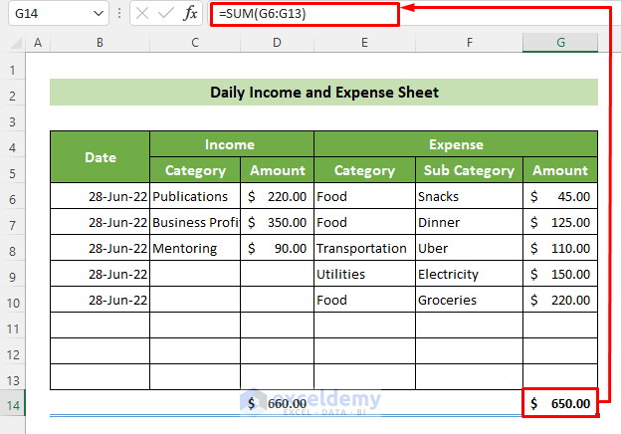
Inputting Family Expenses into Vamsi
Collect all expense data from bank statements, receipts, and bills.
Enter the expenses into Vamsi using its user-friendly data entry interface.
Ensure that data is accurate and updated regularly for precise calculations.
Notes:
Image source: https://www.exceldemy.com

Slide 6
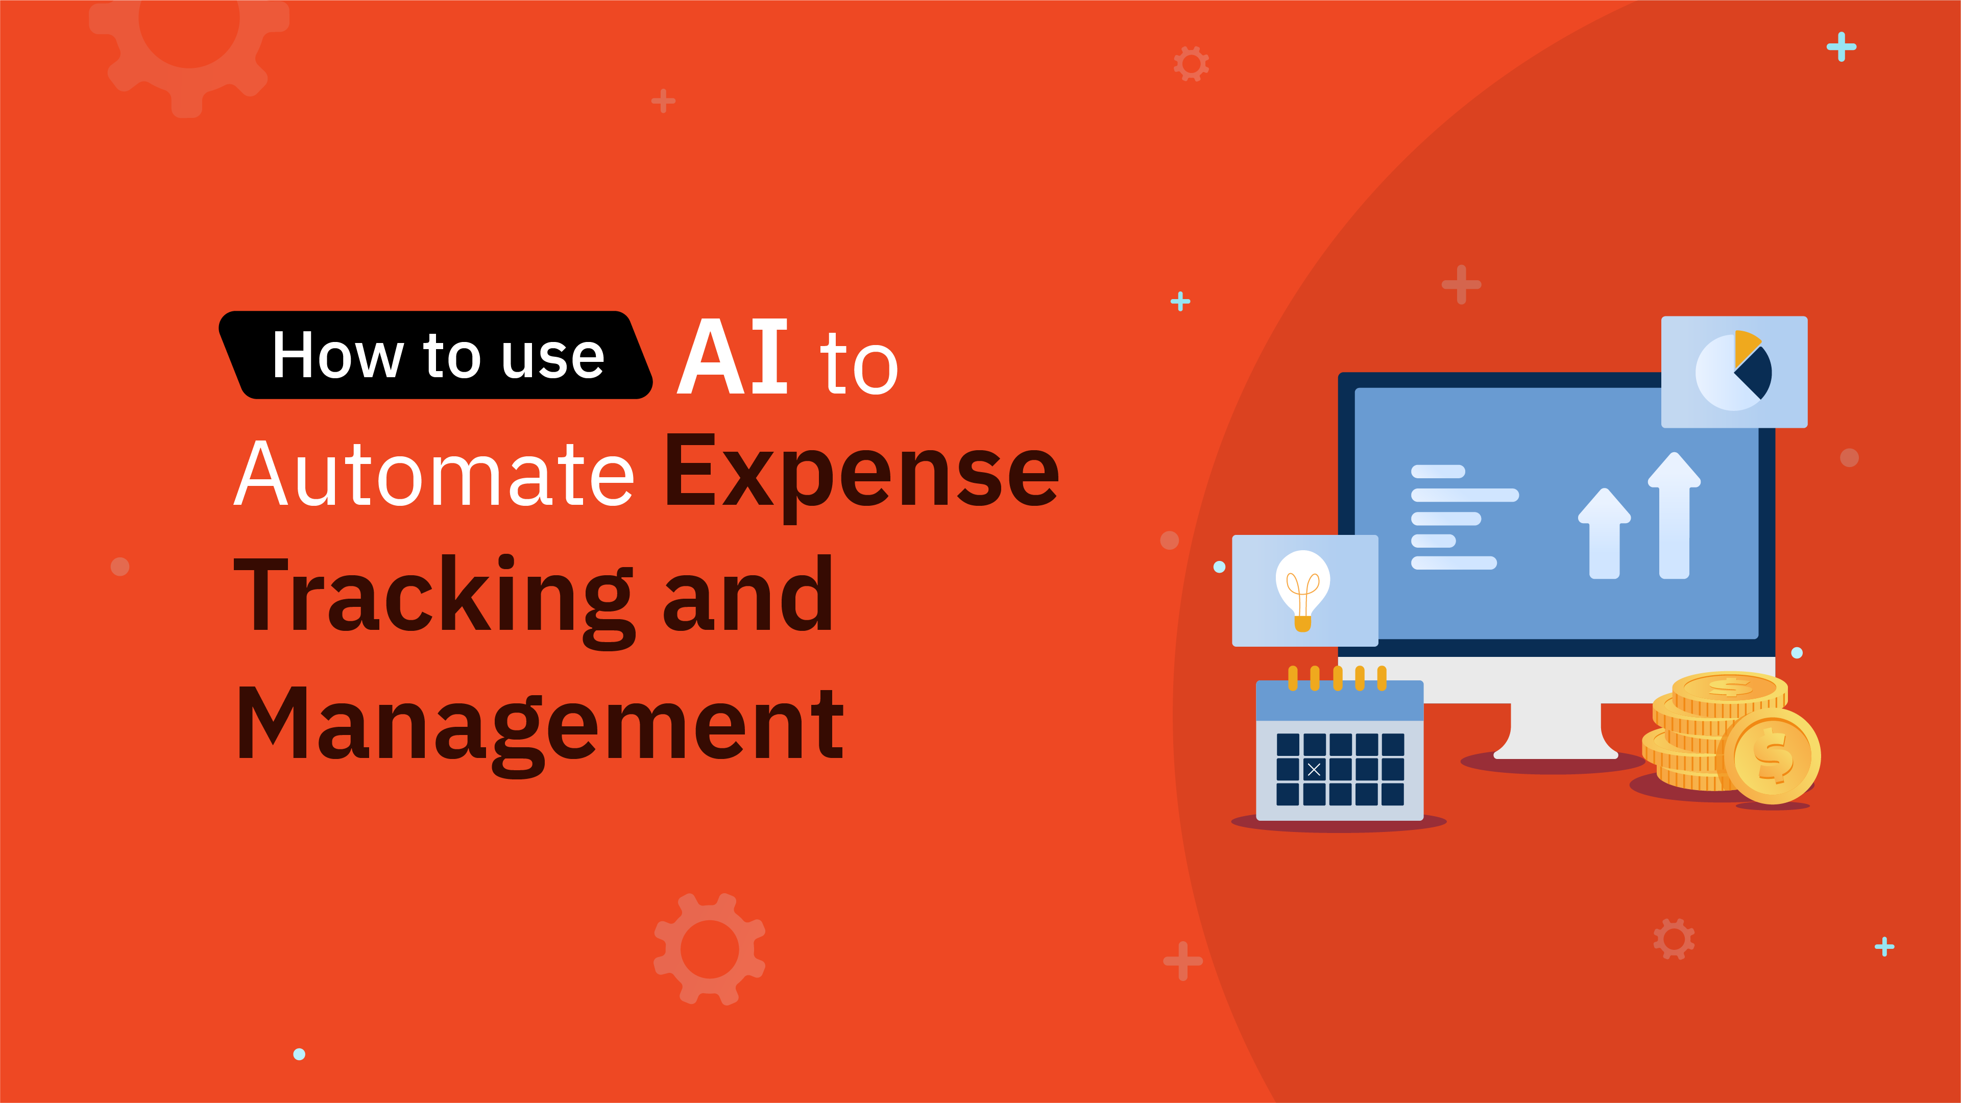
Automating Expense Tracking and Calculation
Vamsi can automate data entry through integrations with bank accounts and financial apps.
The platform calculates totals for each expense category automatically.
Automation reduces manual effort and minimizes errors in expense tracking.
Notes:
Image source: https://instabase.com

Slide 7
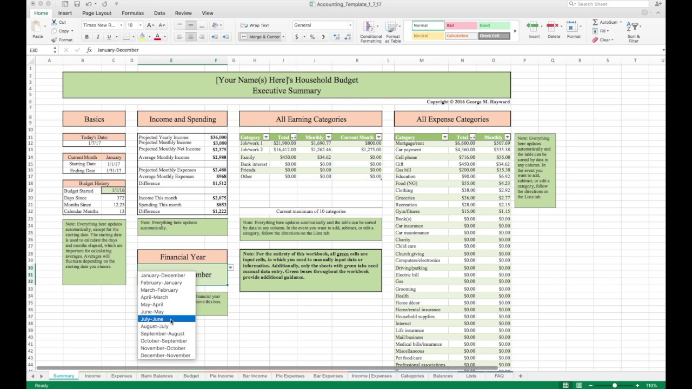
Analyzing Family Expense Data
Use Vamsi’s analytical tools to identify spending trends and anomalies.
Generate reports to compare expenses across different periods.
Insights from analysis assist families in making informed budgeting decisions.
Notes:
Image source: https://i.ytimg.com

Slide 8
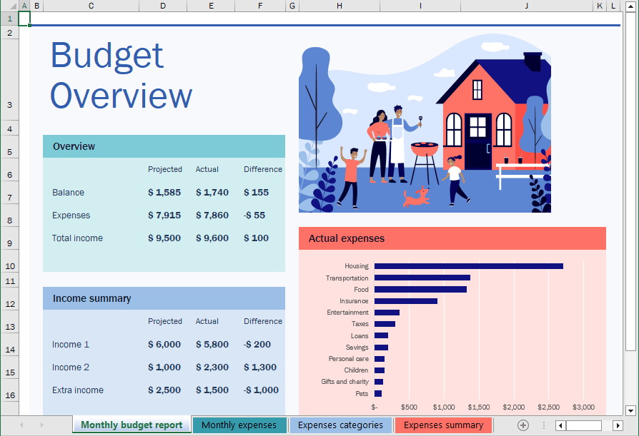
Optimizing Family Budget with Vamsi
Based on expense analysis, families can set realistic budget limits for each category.
Vamsi helps monitor adherence to budget goals through real-time alerts.
Continuous optimization ensures better financial stability and savings.
Notes:
Image source: https://www.officetooltips.com

Slide 9

Conclusion and Benefits of Using Vamsi for Family Expenses
ServiceNow Vamsi simplifies the process of calculating and managing family expenses.
It provides valuable insights that support smarter financial planning.
Implementing Vamsi can lead to improved financial health and peace of mind for families.
Notes:
Image source: https://img.freepik.com

